Slide 1




Slide 2
AI-Powered Soccer Analysis
Detection, Tracking, and Key Point Mapping
Digital Egyptian Pioneers Initiative Graduation Project
10/25/2024

Slide 3

Team Members
Ayatollah Elkolally
Mohamed Mosaad
Khaled Ashraf
Mahmoud El-Morsy
Mariam Mostafa
Abdullrhman Ramadan
Malek Fathey
Ali Elsabaa
Mohamed Ashraf

Slide 4
Project Overview
This project develops an AI system for real-time analysis of soccer matches.
Focuses on detecting players, referees, and the ball, and their movements.
Uses computer vision to map field key points and project player positions onto a radar-like view for tactical analysis.
Combines object detection, tracking, and visual projection techniques to enhance understanding of match dynamics.

Slide 5
Problem Definition
Limited Real-time Insights: Current soccer analysis tools don’t provide comprehensive real-time tracking of players and ball movement.
Manual Data Collection: Traditional methods are time-consuming.
Limited Visualization: Existing systems lack detailed visualization of team strategies and player positioning.
Tracking Challenges: Difficulty in consistently detecting and tracking players, referees, and the ball for accurate analysis.

Slide 6
Technologies and Tools used
OpenCV
Video processing and object detection.
YOLO (You Only Look Once)
Real-time player, ball, and referee detection.
DeepSORT
Multi-object tracking for continuous identification.
Python
Primary programming language for implementation.
Google Colab
Model training and experimentation platform.
OpenGL
Visualization of match analysis and movements.
Microsoft Visual Studio
IDE for code management and debugging.

Slide 7
Object Detection

Slide 8
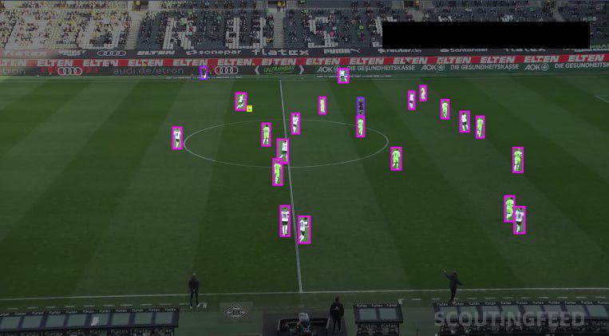
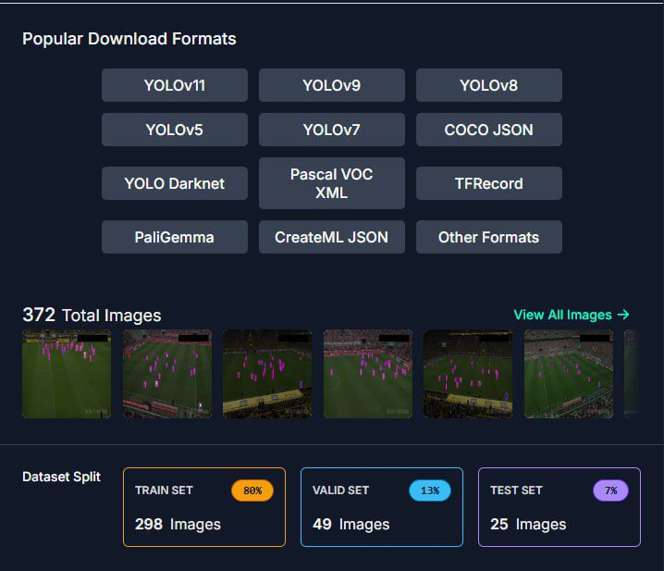
Dataset
We used a labeled sports dataset from Roboflow with annotated player, ball, and referee positions, tailored for YOLO model training and fine-tuning.

Slide 9
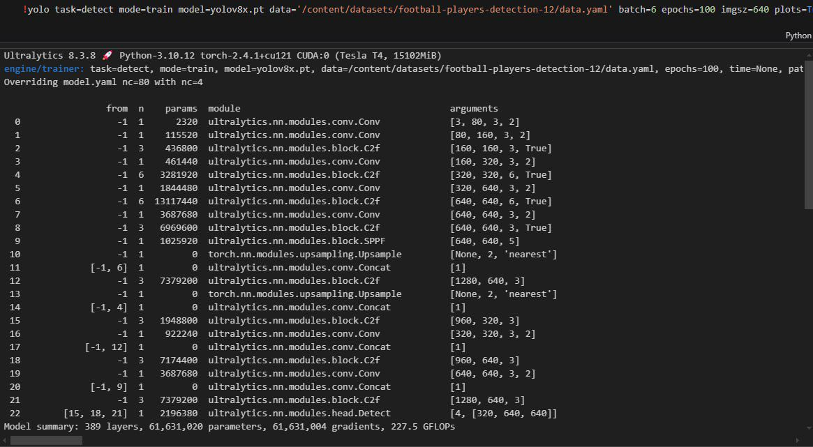
YOLO Model
The YOLO object detection model, identifies players, balls, and other game elements in real-time by processing video frames and generating bounding boxes with confidence scores.

Slide 10
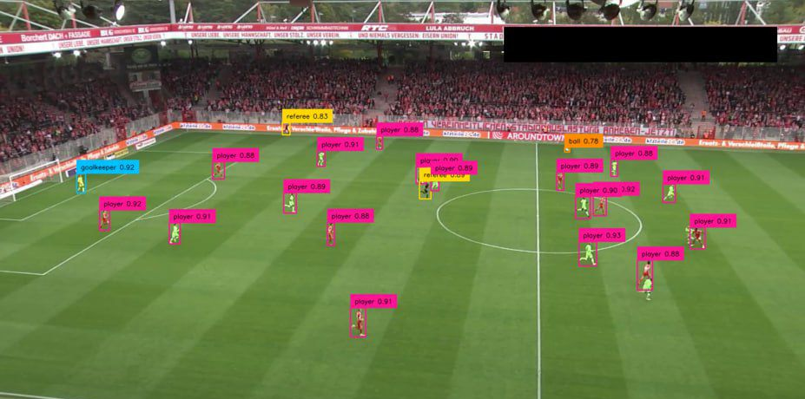
Object Detection
Each video frame is analyzed to detect and classify objects, producing labeled outputs that highlight players and ball locations using supervision tools for visual annotation

Slide 11
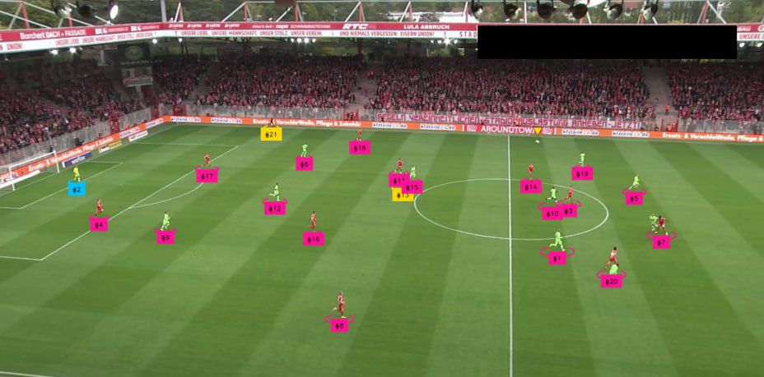
Player ID
After Identifying players, ball and referee, each player is given an id which help having records for each player separately.

Slide 12
Team Classification & Goalkeeper Resolution

Slide 13
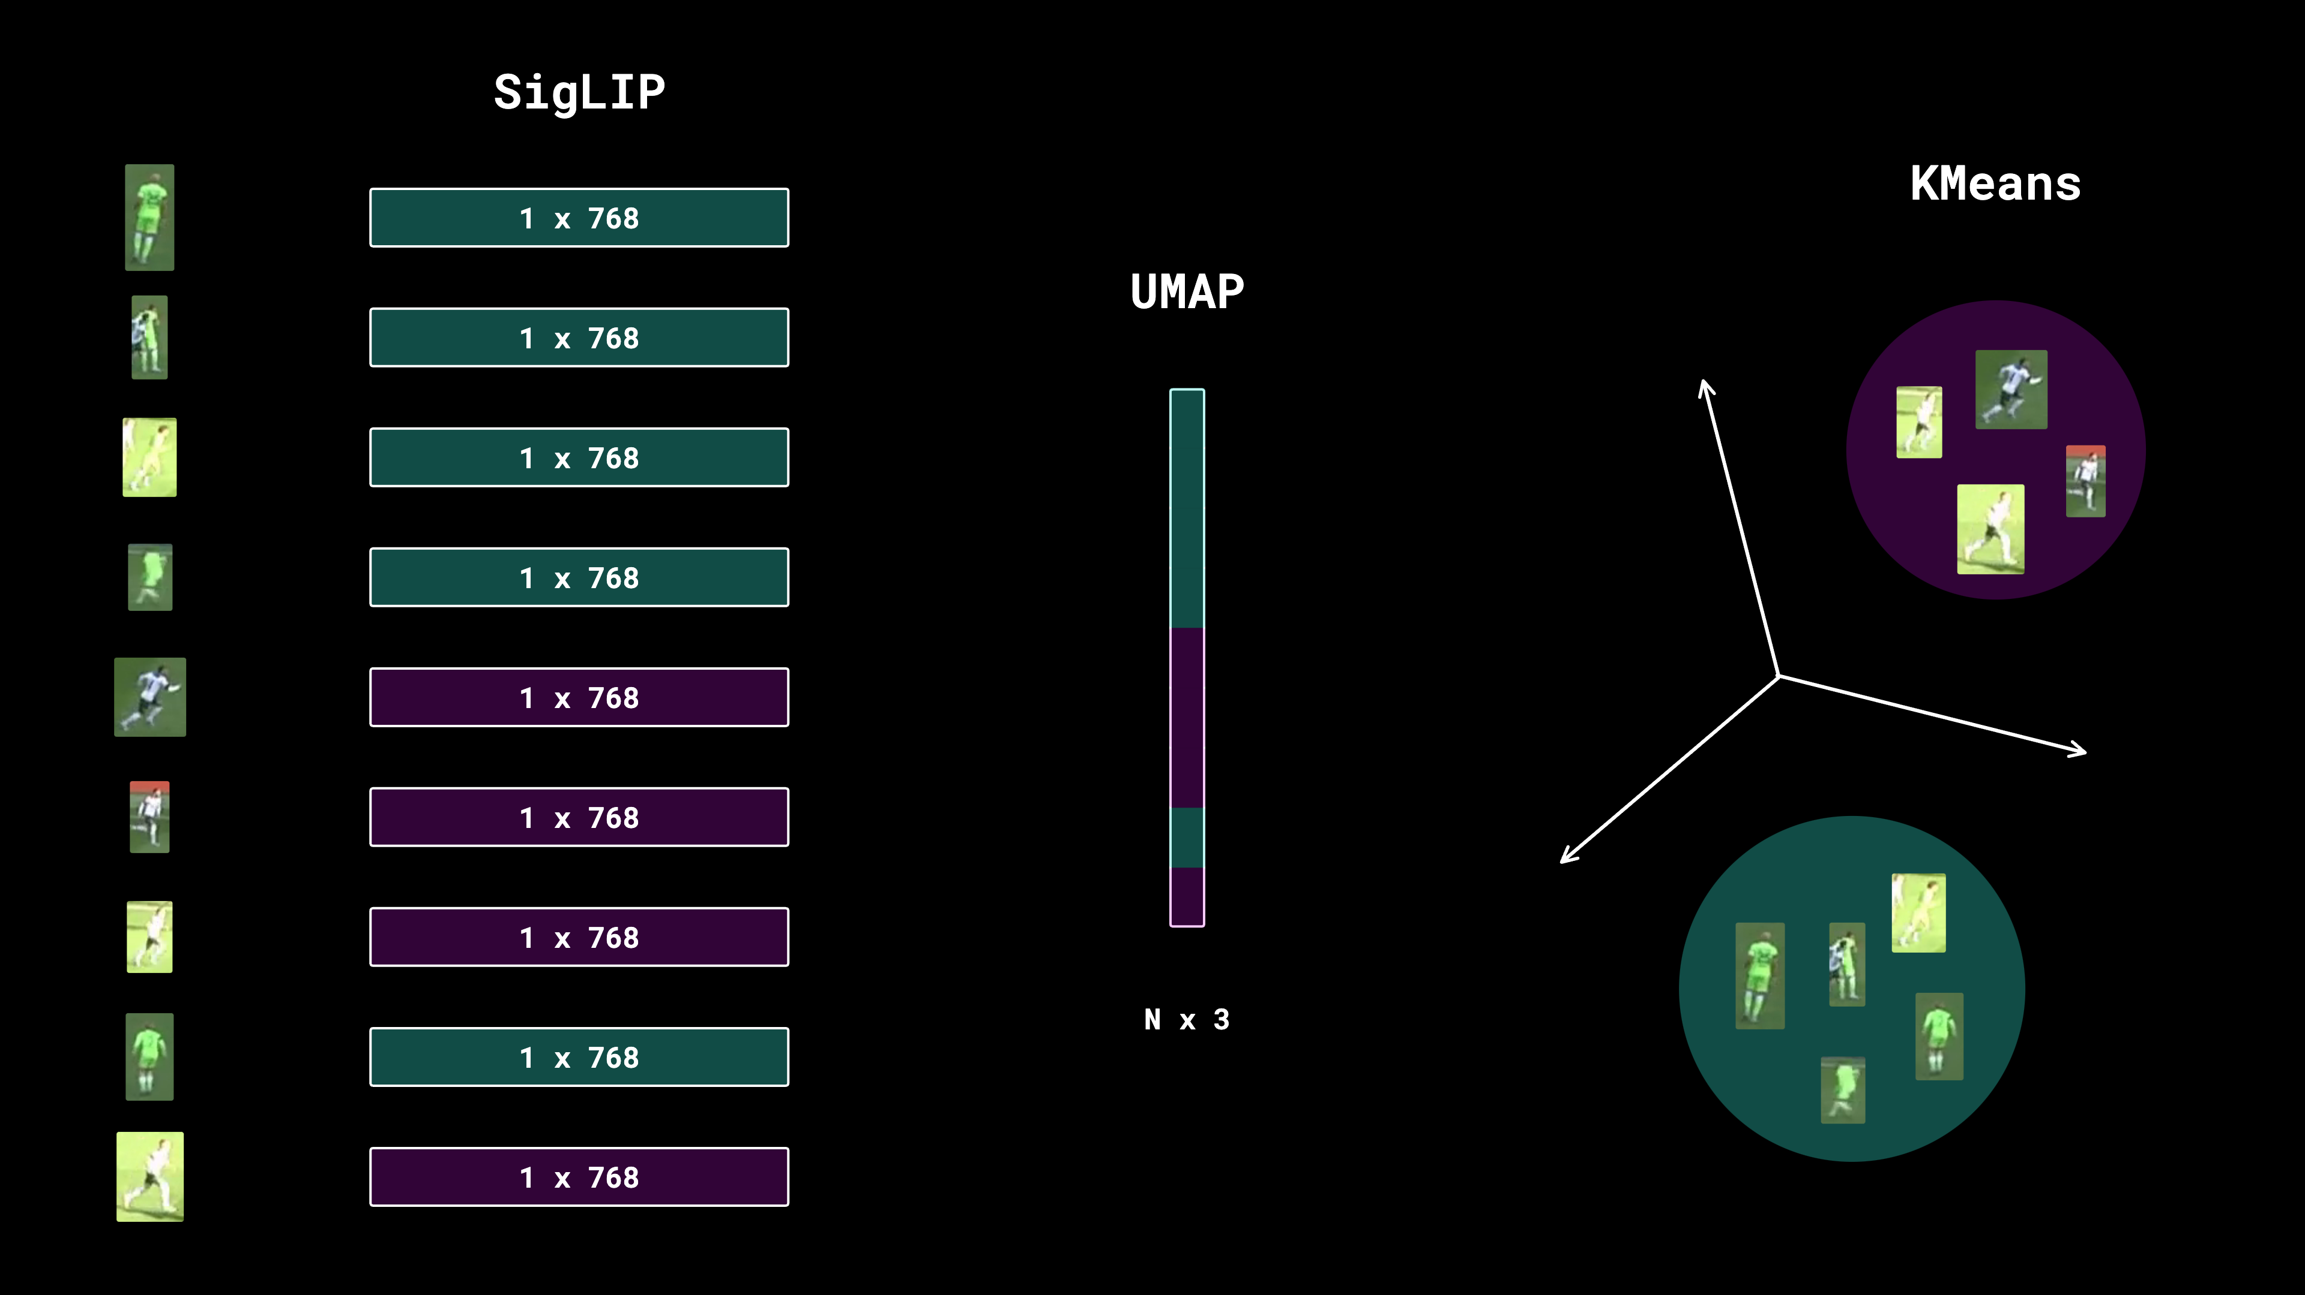
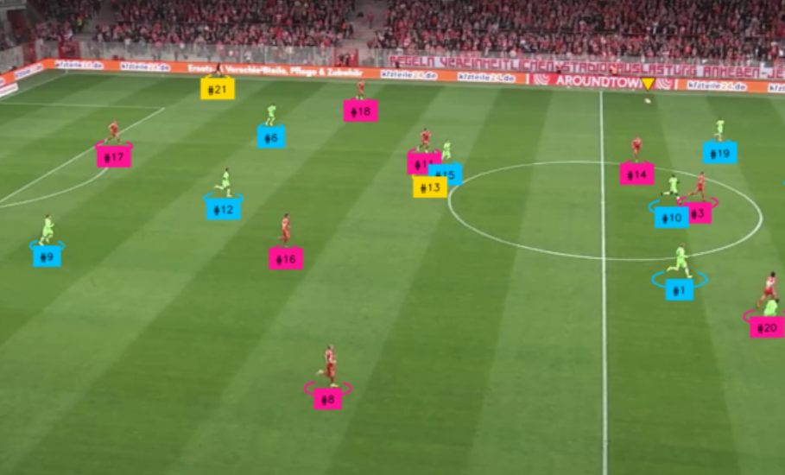
Team Classification & Goalkeeper Resolution
Team Classification:
Method:
Crop detected player images.
Use a Team Classifier model to predict team affiliation.
Outcome: Assign each player a team ID
Goalkeeper Resolution:
Challenge: Identify which goalkeeper belongs to which team.
Solution:
Analyze player positions.

Slide 14
Pitch Key Point Detection

Slide 15
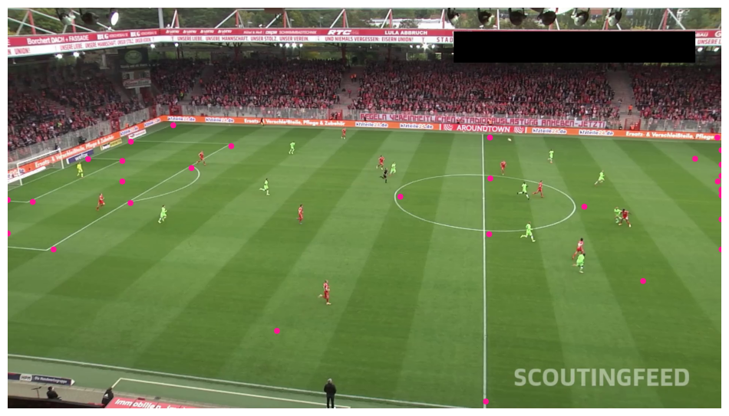
Pitch Key Point Detection
Method:
Analyze video frames to extract key points.
Filter low-confidence key points to ensure accuracy.
Key Points Detected:
Important areas on the pitch such as corners, center, and goal areas.
Significance:
Provides spatial reference for player and ball tracking.
Facilitates visualizations like pitch overlays and strategic analysis.

Slide 16
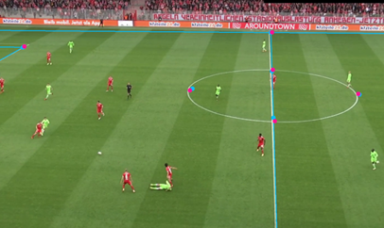
Projecting Data onto the Pitch
Visual Representation: Overlay positions onto the pitch layout.
Components Projected:
Player positions: Colored markers for team identification.
Ball location: Highlighted for tracking.
Referee positions: Indicated for monitoring.
Benefits:
Enhances game dynamics understanding.
Supports tactical analysis and decision-making.

Slide 17
Radar View & Voronoi Diagram

Slide 18
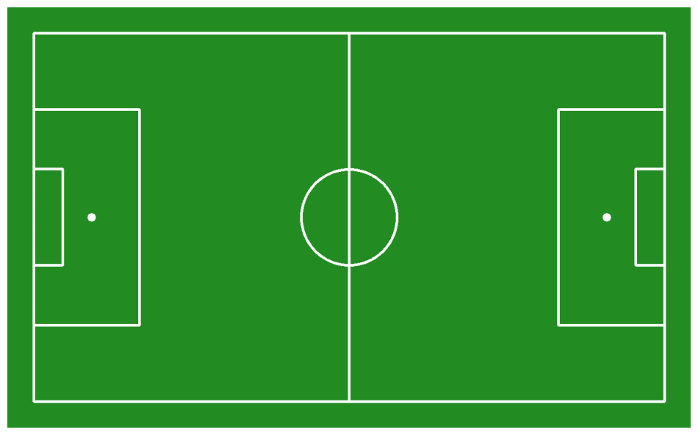
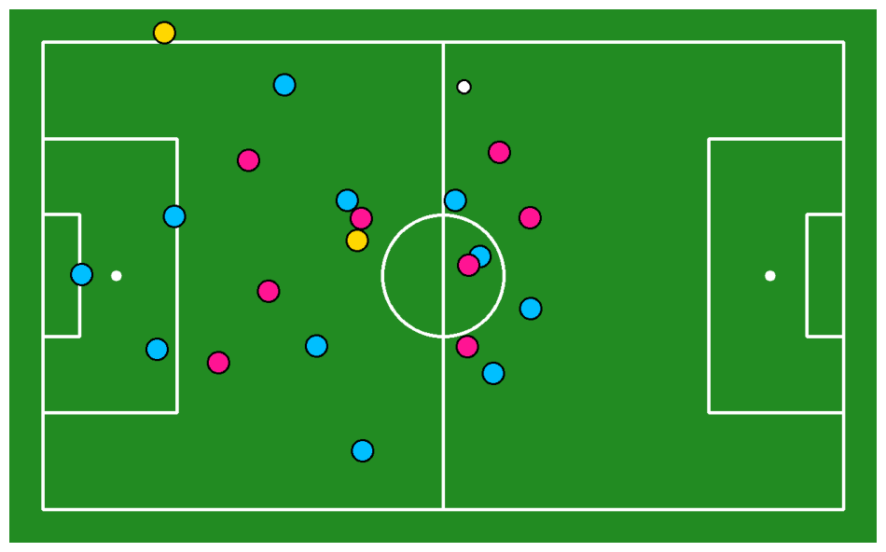
Radar View
Displays the complete annotated pitch with all drawn elements (ball, players, referees)

Slide 19
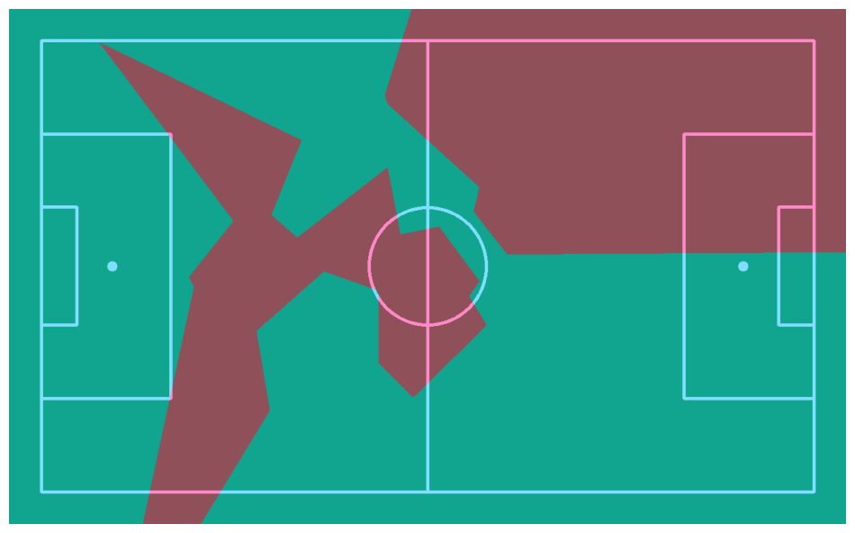
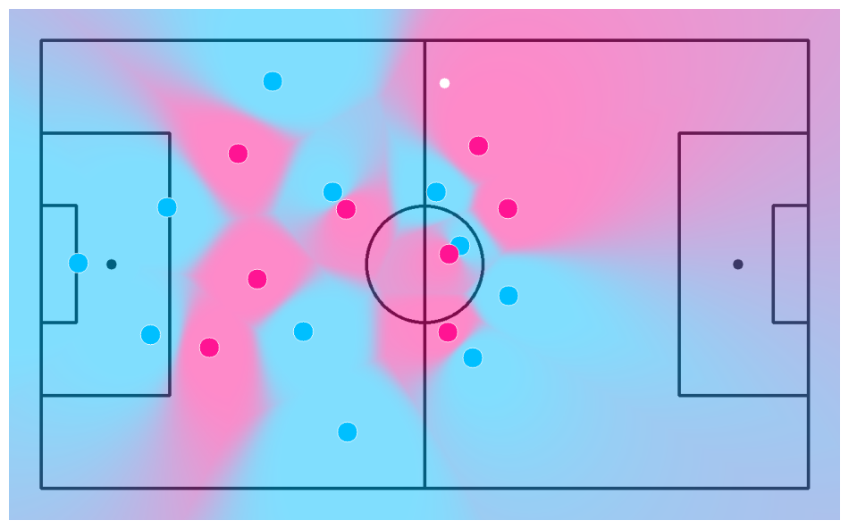
Voronoi Diagram
Displays the final pitch with the blended Voronoi diagram, ball, and player representations to show areas controlled by each team.

Slide 20
Key Challenges and Limitations
Detection Accuracy:
Variability in player appearances can affect detection rates.
Complex Environments:
Overlapping players and occlusions complicate tracking.
Real-time Processing:
High-resolution video poses computational challenges for real-time analysis.
Data Quality:
Inconsistent video quality can hinder detection effectiveness.

Slide 21
Output Process
Player Detection Output:
Heatmap Output:
Voronoi Diagram Output
Reassembling the Frames:
Frames highlight detected players with bounding boxes, showing their positions and movements.
Frames visualize player activity areas on the field through heatmaps.
Frames illustrate the Voronoi diagram, indicating field coverage based on player positions.
All frames are compiled into separate videos for each analysis and merged into a comprehensive final video.

Slide 22
Future Work
Real-time Implementation: Develop a more efficient processing pipeline for real-time analysis in live games.
User Interface: Create a user-friendly dashboard for coaches and analysts to visualize data and insights.
Multi-Sport Application: Adapt the technology for use in other sports to broaden its impact.
User Feedback Integration: Gather insights from end-users to refine features and functionalities.

Slide 23
THANKS!

